Slide 1
JAVA SCRIPT

Slide 2
Introduction
JavaScript is an interpreted programming language and functional programming language.
Script contained in web documents can be read by the browser’s JavaScript engine whenever the document is loaded into the browser window.
JavaScript appeared in December 1995,was initially called as LiveScript.

Slide 3
Including JavaScript in HTML
JavaScript code can be embedded in a Web page using <script>….</script> tags.
We can place <script> …</script> tag in the body or head portion of the HTML document.
  <script> tag in body portion:
    When we want script to run while web page is loading in web browser.
    <script> tag in head portion:
        When we want script to run only when user performs some actions such as clicking a link.

Slide 4
Ex:
type and language attribute conveys:
To the web browser that HTML document contains script written in JavaScript
<html>
<head>
<title>My Page</title>
</head>
<body>
<script
type=“text/javascript” language="JavaScript">
document.write(“Creating a script in an HTML document”);
</script>
</body>
</html>
NOTE:
There is no limit to the number of scripts that you can add in an HTML document

Slide 5
Using an External Script file
Create a separate script file containing:
document.write(“Using an External script file”);
Save above contents in script file say myscript.js
And then link myscript.js file with the HTML document by using src attribute of the <script> tag as follows:
  <script src=“myscript.js”> </script>
  There is no script is written in script tag. In case if it is written then that code will not get processed.

Slide 6
JavaScript Variables
Variables are used to store data.
A variable's value can change during the script. You can refer to a variable by name to see its value or to change its value.
Syntax:
var variable-name;
Where var is keyword
Rules for variable names:
  Variable names are case sensitive
  They must begin with a letter or the underscore character
    strname – STRNAME (not same)

Slide 7
JavaScript Variables
Rules for variable names:
  Variable names are case sensitive
  They must begin with a letter or the underscore character.
  They should not contain punctuation mark and space.
  The name of variable cannot be enclosed by single or double quotation marks
  The name of the variable cannot be same as any keyword in JavaScript.
  Ex: Invalid variables-
  89books,var,My*variable ,”count” ,_Book titles
  Valid variables-
  books89,var1,My_variable,count,Book_titles

Slide 8
JavaScript Variables
    Ex:
    var countbooks;
    var countbooks,minbookprice,x,y;
    var countbooks=200,x=5,y=9;

Slide 9
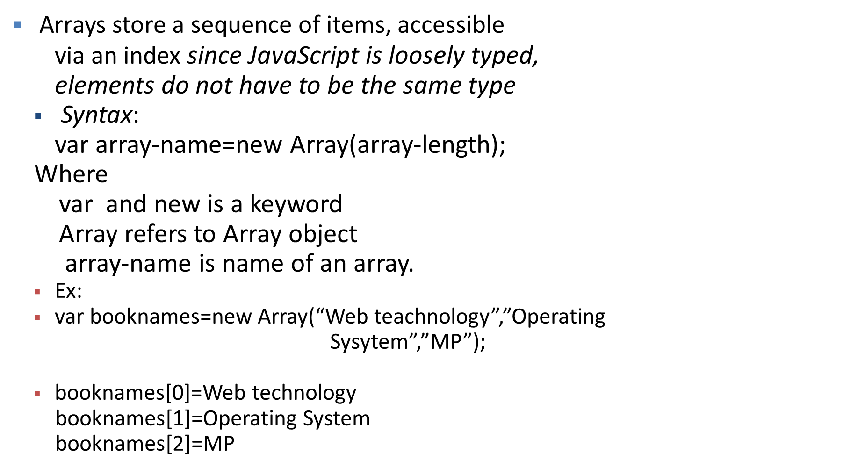
JavaScript Arrays

Slide 10
Array Example
<script language=“JavaScript”>
var Car = new Array(3);
Car[0] = “Ford”;
Car[1] = “Toyota”;
Car[2] = “Honda”;
document.write(Car[0] + “<br>”);
document.write(Car[1] + “<br>”);
document.write(Car[2] + “<br>”);
</script>

Slide 11
  to create an array, allocate space using new (or can assign directly)
    items = new Array(10); // allocates space for 10 items
    items = new Array(); // if no size given, will adjust dynamically
    items = [0,0,0,0,0,0,0,0,0,0]; // can assign size & value[]
  to access an array element, use [] (as in C++/Java)
    for (i = 0; i < 10; i++) {
    items[i] = 0; // stores 0 at each index
    }
  the length property stores the number of items in the array
    for (i = 0; i < items.length; i++) {
    document.write(items[i] + "<br>");// displays elements
    }

Slide 12
Using Array methods
Methods :
  1. length
  2. reverse
  3.sort
  4. concat
  5. join

Slide 13
Ex:
<script type=“text/javascript” language=“javascript”>
var bookprices=new Array(3);
var booknames= new Array(“OS”,”MP”,”WT”,”SOOSE”);
bookprice[0]=150;
bookprice[1]=100;
bookprice[2]=90;
document.write(bookprices.length);
document.write(booknames.reverse());
document.write(booknames.sort());
</script>
-----3
------SOOSE,WT,MP,OS
-----90,100,150

Slide 14
Concat() and join() of arrays
var x = ["Cecilie", "Lone"];
var y = ["Emil", "Tobias", "Linus"];
var children = x.concat(y);
document.write(children);
O/P: Cecilie,Lone,Emil,Tobias,Linus
var fruits = ["Banana", "Orange", "Apple","Mango"];
document.write(fruits.join());
O/P: Banana,Orange,Apple,Mango

Slide 15
Accessing the property and method of Date object:
Ex:
var dt=new Date();---get the object reference of Date class
var day=dt.getDay();---returns current day no(0 to 6)
var month=dt.getMonth()-returns current month no(0 to 11)
var year=dt.getYear()---returns current year
var date=dt.getDate()--- returns current day(1 to 31)
Accessing the property and method of String object:
Ex:
st.bold();----Makes string bold
st.concat(str);----concates str to st
st. substring(6,17);---gets substring from position 6 to 17
st.toLowerCase();---converts string to lowercase
st.toupperCase().;---coverts string to uppercse

Slide 16
Accessing the property and method of String object:
Ex:
if(st.match(/javascript/))
Checks javascript is a part of string or not
If(str.replace(/(Happy)/,”Enjoy”)
Replaces Happy string by Enjoy string

Slide 17
Operators
Arithmetic operators
Logical operators
Comparison operators
String operators
Bit-wise operators
Assignment operators
Conditional operators

Slide 18
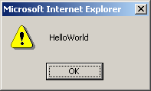
String operator
JavaScript only supports one string operator for joining two strings.
Operator | Name | Description | Return value
+ | String concatenation | Joins two strings | “HelloWorld”
<script language=“JavaScript”>
var myString = “”;
myString = “Hello” + “World”;
alert(myString);
</script>

Slide 19
Bit Manipulation operators
Perform operations on the bit representation of a value, such as shift left or right.
Operator | Name | Description
& | Bitwise AND | Examines each bit position
| | Bitwise OR | If either bit of the operands is 1, the result will be 1
^ | Bitwise XOR | Set the result bit, only if either bit is 1, but not both
<< | Bitwise left shift | Shifts the bits of an expression to the left
>> | Bitwise signed right shift | Shifts the bits to the right, and maintains the sign
>>> | Bitwise zero-fill right shift | Shifts the bits of an expression to right

Slide 20
Assignment operators
Operator | Description | Example
= | Assigns the value of the right operand to the left operand | A = 2
+= | Add the operands and assigns the result to the left operand | A += 5
-= | Subtracts the operands and assigns the result to the left operand | A -= 5
*= | Multiplies the operands and assigns the result to the left operand | A *= 5
/= | Divides the left operands by the right operand and assigns the result to the left operand | A /= 5
%= | Assigns the remainder to the left operand | A %= 2

Slide 21
Order of Precedence
Precedence | Operator
1 | Parentheses, function calls
2 | , ~, -, ++, --, new, void, delete
3 | *, /, %
4 | +, -
5 | <<, >>, >>>
6 | <, <=, >, >=
7 | ==, !=, ===, !==
8 | &
9 | ^
10 | |
11 | &&
12 | ||
13 | ?:
14 | =, +=, -=, *=, …
15 | The comma (,) operator

Slide 22
Precedence Example
Value = (19 % 4) / 1 – 1 - !false
Value = 3 / 1 – 1 - !false
Value = 3 / 1 – 1 - true
Value = 3 – 1 - true
Value = 3 – 2
Value = 1

Slide 23
Control Flow Statements

Slide 24
“if” statement
if (condition) { statements; }
It is the main conditional statement in JavaScript.
The keyword “if” always appears in lowercase.
The condition yields a logical true or false value.
The condition is true, statements are executed.

Slide 25
“if” statement example
<script language=“JavaScript”>
var chr = “”;
…
if (chr == ‘A’ || chr == ‘O’) {
document.write(“Vowel variable”);
}
</script>

Slide 26
“if … else” statement
if (condition) { statements; }
else { statements; }
You can include an “else” clause in an if statement when you want to execute some statements if the condition is false.

Slide 27
Ternary Shortcut (concise)
<script language=“JavaScript”>
If (3 > 2) {
alert(“True”);
} else {
alert(“False”);
}
(3 > 2) ? alert(“True”) : alert(“False”);
</script>
Substitute for a simple “if/else” statement.

Slide 28
“else if” statement
if (condition) { statement; }
else if (condition) { statement; }
else { statement; }
Allows you to test for multiple expression for one true value and executes a particular block of code.

Slide 29
“if/if…else” statement example
<script language=“JavaScript”>
var chr;
chr = prompt(“Please enter a character : “,””);
if (chr >= ‘A’){
if (chr <= ‘Z’)
alert(“Uppercase”);
else if (chr >= ‘a’){
alert(“Lowercase”);
}
}
</script>

Slide 30
“switch” statement
switch (expression) {
case label1:
statements; break;
default:
statements;
}
Allows you to merge several evaluation tests of the same variable into a single block of statements.

Slide 31
“switch” statement example
<script language=“JavaScript”>
var chr;
chr = prompt(“Pls enter a character in lowercase:”,””);
switch(chr){
case ‘a’ :
alert(“Vowel a”); break;
case ‘e’ :
alert(“Vowel e”); break;
default :
alert(“Not a vowel”);
}
</script>

Slide 32
Looping Statement
“for” Loops
“while” Loops
“do … while” Loops
“break” statement
“continue” statement

Slide 33
“for” statement
for (initial_expression; test_exp; change_exp)
{ statements; }
One of the most used and familiar loops is the for loop.
It iterates through a sequence of statements for a number of times controlled by a condition.
The change_exp determines how much has been added or subtracted from the counter variable.

Slide 34
“for” statement example
<script language=“JavaScript”>
var counter;
for (counter = 1; counter <= 10; counter++)
{
document.write(counter*counter + “ “);
}
</script>
Display the square of numbers
Output: 1 4 9 16 25 36 49 64 81 100

Slide 35
“while” statement
initial value declaration;
while (condition) {
statements;
increment/decrement statement;
}
The while loop begins with a termination condition and keeps looping until the termination condition is met.
The counter variable is managed by the context of the statements inside the curly braces.

Slide 36
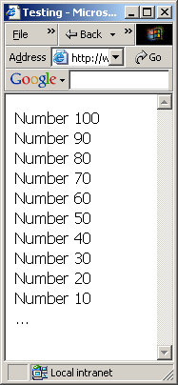
“While” statement example
<html>
<head>
<title>While loop example</title>
<script language=“JavaScript”>
var counter = 100;
var numberlist = “”;
while (counter > 0) {
  numberlist += “Number “ + counter + “<br>”;
  counter -= 10;
}
document.write(numberlist);
</script> <body> … </body>
</html>

Slide 37
“do … while” statement
do {
statements;
counter increment/decrement;
} while (termination condition)
The do/while loop always executes statements in the loop in the first iteration of the loop.
The termination condition is placed at the bottom of the loop.

Slide 38
JUMP statements
Break statement:
It was used to "jump out" of a switch() statement.
The break statement breaks the loop and continues executing the code after the loop (if any)
Ex:
for (i = 0; i < 10; i++) {
if (i == 3)
break ;
text += "The number is " + i + "<br>";
}

Slide 39
JUMP statements
2) Continue statement:
The continue statement breaks one iteration (in the loop), if a specified condition occurs, and continues with the next iteration in the loop.
Ex:
for (i = 0; i <= 10; i++)
{
if (i == 3) continue;
text += "The number is " + i + "<br>";
}

Slide 40
FUNCTIONS

Slide 41
Functions are a single block of organized code that performs some task
Syntax to write a funtion:
  function functionName(parameter1, parameter,parameter3)
  {
  code to be executed
  }
  Ex:
  var x = myFunction(4, 3); // Function call
  function myFunction(a, b)
    {
  return a * b; // Function returns the product of a and b
  }
Keyword

Slide 42
Common JavaScript Methods

Slide 43
alert()
<head>
<script language=“JavaScript”>
alert(“An alert triggered by JavaScript”);
</script>
</head>
It is the easiest methods to use amongst alert(), prompt() and confirm().
You can use it to display textual information to the user (simple and concise).
The user can simply click “OK” to close it.

Slide 44
confirm()
<head>
<script language=“JavaScript”>
confirm(“Are you happy with the class?”);
</script>
</head>
This box is used to give the user a choice either OK or Cancel.
It is very similar to the “alert()” method.
You can also put your message in the method.

Slide 45
prompt()
<head>
<script language=“JavaScript”>
prompt(“What is your student id number?”);
prompt(“What is your name?”,”No name”);
</script>
</head>
This is the only one that allows the user to type in his own response to the specific question.
You can give a default value to avoid displaying “undefined”.

Slide 46
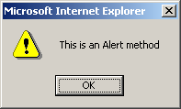
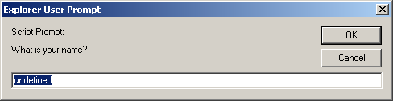
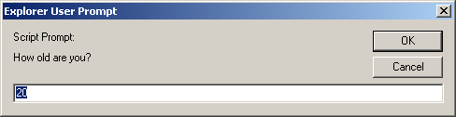
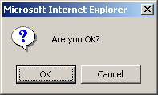
<script language="JavaScript">
alert("This is an Alert method");
confirm("Are you OK?");
prompt("What is your name?");
prompt("How old are you?","20");
</script>
INE2720 – Web Application Software Development
All copyrights reserved by C.C. Cheung 2003.

Slide 47
Event Handling in JAVASCRIPT
onclick()
onload()
onmouseover()
onreset()
onsubmit()
08/12/17

Slide 48
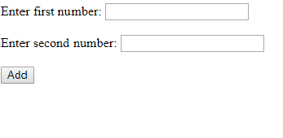
Ex: Add two nos using form and javascript
08/12/17

Slide 49
<html>
<head>
<title>Addition of two nos</title>
</head>
<body>
<script>
var a=parseInt(prompt("Enter no1"));
var b=parseInt(prompt("Enter no2"));
document.write(a+b);
</script>
</body>
</html>

Slide 50
getElementById() Method
The getElementById() method returns the element that has the ID attribute with the specified value.
This method is one of the most common methods in the HTML DOM, and is used almost every time you want to manipulate, or get info from, an element on your document.
Returns null if no elements with the specified ID exists.
An ID should be unique within a page. However, if more than one element with the specified ID exists, the getElementById() method returns the first element in the source code.
08/12/17

Slide 51
innerHTML
innerHTML is a DOM property to insert content to a specified id of an element
Each HTML element has an innerHTML property that defines both the HTML code and the text that occurs between that element's opening and closing tag
Ex:
To display a result value on same window or tab
document.getElementById("demo").innerHTML =c;
08/12/17

Slide 52
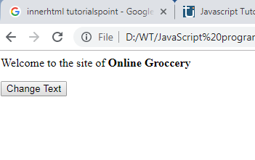
Ex of innerHTML
<body>
<script type="text/javascript">
function changeText()
{
document.getElementById('boldStuff').innerHTML = 'Online Groccery ';
}
</script>
<p>Welcome to the site of <b id='boldStuff'>dude</b> </p>
<input type='button' onclick='changeText()' value='Change Text'/>
</body>
08/12/17

Slide 53
Ex of innerHTML
Ex:Updating text based on user input
<script type="text/javascript">
function changeText2()
{
var userInput =document.getElementById('userInput').value; document.getElementById('boldStuff2').innerHTML = userInput;
}
</script> <p>Welcome to the site <b id='boldStuff2‘>XYZ</b> </p> <input type='text' id='userInput' value='Enter Text Here' />
<input type='button' onclick='changeText2()' value='Change Text'/>
08/12/17

Slide 54
Ex of innerHTML
Ex: Changing text color with innerhtml
<script type="text/javascript">
function changeText3()
{ var oldHTML = document.getElementById('para').innerHTML;
var newHTML = "<span style='color:#ffffff'>" + oldHTML + "</span>“; document.getElementById('para').innerHTML = newHTML;
}
</script>
<p id='para'>Welcome to the site <b id='boldStuff3‘>XYZ</b> </p>
<input type='button' onclick='changeText3()' value='Change Text'/>
08/12/17

Slide 55
<body>
Enter first number:
<input type="text" name="first" id="no1" >
<br></br>
Enter second number:
<input type="text" name="second" id="no2">
<br></br>
<input type="button" name="add" value="Add" onclick="finput()">
<p id="demo"> </p>
</body>
</html>
<html>
<head>
<script>
function finput()
{
var c,a,b;
a=parseInt(document.getElementById("no1").value);
b=parseInt(document.getElementById("no2").value);
c=fnadd(a,b);
document.getElementById("demo").
innerHTML =c;
}
function fnadd(a,b)
{
return (a+b);
}</script> </head>

Slide 56
Constructor property of Javascript String/Number class(builtin class)
A constructor returns a reference to the string function that created the instance's prototype.
Syntax:
string.constructor;
Ex:
var str = new String( "This is string" );
document.write("str.constructor is:" + str.constructor);
Output:
str.constructor is: function String() { [native code] }
var str = new Number( "12314" );
document.write("str.constructor is:" + str.constructor);
Output:
str.constructor is: function Number() { [native code] }

Slide 57
Form Validation

Slide 58
Regular Expression
1. Regular expressions are patterns used to match character combinations in strings.
2. In JavaScript, regular expressions are also objects(describes the pattern of characters).
3.Regular expressions are used to perform pattern-matching and "search-and-replace" functions on text.
4. These patterns are used with two methods
exec and test methods of RegExp class,
and also with the
match, replace, search, and split methods of String.

Slide 59
RegExp Object
The RegExp constructor creates a regular expression object for matching text with a pattern.
Syntax:
1. new RegExp(pattern,[, flags])
2. /pattern/flags
Ex:
var regexConst = new RegExp('abc');
var regexLiteral = /abc/;
08/12/17

Slide 60
RegExp Object
Ex: constructor property
var patt = new RegExp("Hello World", "g");
var res = patt.constructor;
Output:----function RegExp() { [native code]
Flags-
g- global match
i-ignore sensitive
m- Multiline check
u-Unicode
y-sticky based on last-index of RE

Slide 61
Matching pattern
exec()
The exec() method tests for a match in a string. This method returns the matched text if it finds a match, otherwise it returns null.
Ex:
var str = "The best things in life are free";
var patt = new RegExp(“life");
var res = patt.exec(str);
OUTPUT: life
08/12/17

Slide 62
Matching pattern
test()
The test() method executes a search for a match between a regular expression and a specified string. Returns true or false.
Ex:
if "hello" is contained at the very beginning of a string, returning a boolean result.
var str = 'hello world!';
var result = /^hello/.test(str);
document.write(“ “+result);
Output: true

Slide 63
Matching pattern with string and RE
Search()
It search for a pattern given as RE with given string and returns the index of the first match otherwise returns -1.
Ex:
var str = "hey JxyZ";
var re = /[A-Z]/;
var re2 = /[.]/;
document.write(“Index:”+(str.search(re)));
document.write(“Index1:”+(str.search(re2)));
Output:
Index:4 Index1:-1

Slide 64
Matching pattern with string and RE
split()
Split a string into an array of substrings
Ex:
var str = "How are you doing today?";
var res = str.split(“ “ );
Output:
How,are,you,doing,today?
NOTE:
1) If empty string is used as a separator then split will happen between each character.
2) It dosenot modify the original string

Slide 65
Regular Expression Escape Characters
Some characters are used in regEx as metasymbols.
| $ ^ ? * + . [] () etc.
To use metasymbols as literals they must be escaped
(prefixed with a backslash - \)
Some characters have no printable symbol.
\n -- matches the new line character
\t -- matches the tab character
\r -- matches the carriage return character
\v -- matches the vertical tab character
\f -- matches the form feed character

Slide 66
Regular Expression Notations
SrNO | Notation | Meaning
1. | \ | A backslash that precedes a special character indicates that the next character is not special and should be interpreted literally. For example, the pattern /a*/ relies on the special character '*' to match 0 or more a's. By contrast, the pattern /a\*/ removes the specialness of the '*' to unable matches with strings like 'a*
2. | ^ | Matches beginning of input For example, /^A/ does not match the 'A' in "an A", but does match the 'A' in "An E".
3. | $ | Matches end of input. For example, /t$/ does not match the 't' in "eater", but does match it in "eat".

Slide 67
Regular Expression Notations
SrNO | Notation | Meaning
4. | * | Matches the preceding expression 0 or more times. Equivalent to {0,}. For example, /bo*/ matches 'boooo' in "A ghost booooed”
5. | + | Matches the preceding expression 1 or more times. Equivalent to {1,}. For example, /a+/ matches the 'a' in "candy" and all the a's in "caaaaaaandy", but nothing in "cndy".
6. | ? | Matches the preceding expression 0 or 1 time. Equivalent to {0,1}. For example colou?r = colour (u is found 1 time) colou?r = color (u is found 0 times)

Slide 68
Regular Expression Notations
SrNO | Notation | Meaning
7 | . | (The decimal point) matches any single character except the newline character. For example, /.n/ matches 'an' and 'on' in "nay, an apple is on the tree", but not 'nay'.
8 | \d | Matches a digit character. Equivalent to [0-9]. For example, /\d/ or /[0-9]/ matches '2' in "B2 is the suite number."
9. | \D | Matches a non-digit character. Equivalent to [^0-9]. For example, /\D/ or /[^0-9]/ matches 'B' in "B2 is the suite number."
10. | \w | A word character. A word character is a letter, a number, or an underscore

Slide 69
Regular Expression Notations
SrNO | Notation | Meaning
11. | {} | the opening and closing curly brackets are used as range quantifiers. Example: "a{2,3}" matches "aa" or "aaa".
12. | [] | the opening and closing square brackets define a character class to match a single character.
13. | () | the opening and closing parentheses are used for grouping characters (or other regexes) Ex:"(ab)\1" matches "abab".
14. | \b | Start of word boundry Ex: ing\b –matches ing if it is at the end of word boundry

Slide 70
Email verification
var p=”[^\\w-_\.]*[\\w-_\.]\@[\\w]\.+[\\w]+[\\w]$”;
[^\\w-_\.]
^ checks the first character is a word character \\w
It can also be and underscore ,hyphen or period.
*[\\w-_\.]
means that next series of characters can be repeated zero or many times.
\@[\\w]\.+
@ is part of mailid (word char.) and then atleast one dot .
[\\w]+[\\w]$
First set makes sure that there are some characters after the dot and last part checks that last character is a word character

